Slide 1

NFC Amiibo Display Shelf
Joaquin Sabin, Dylan Robens, Austin Weber, Alex Schroeder

Slide 2
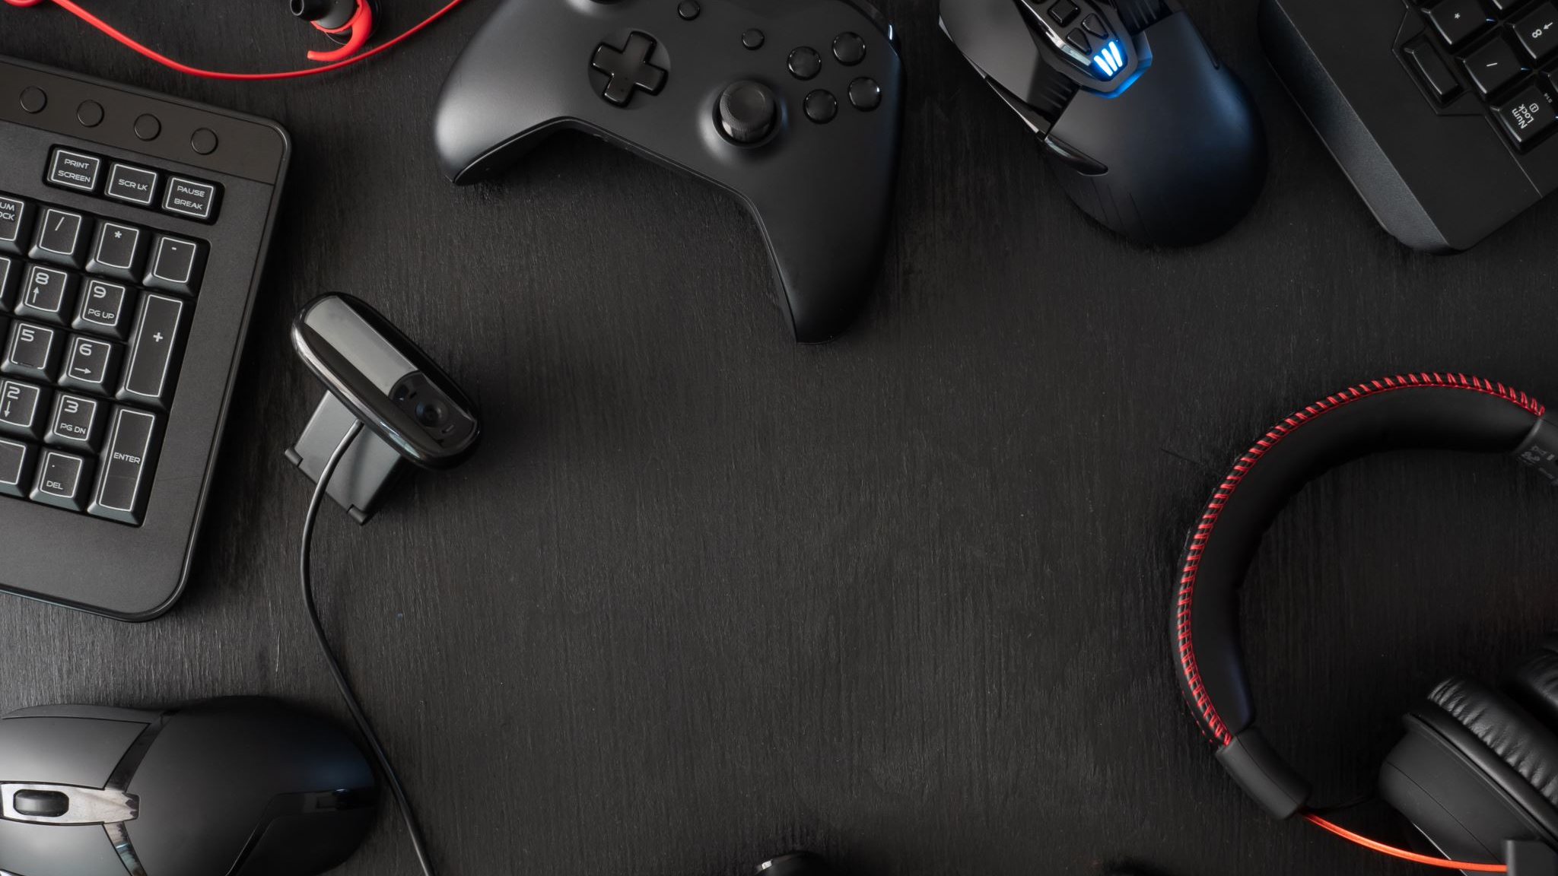
General Information
This project is meant to satisfy a need for people to display their Amiibo in a cool and unique way.
Our philosophy for this project is that we treat this as if we were designing a product.
An Amiibo, is a collectable figurine that is manufactured and sold by Nintendo, and have been a widely popular item across the world.
Amiibo have an NFC chip inside of them which allows the figure to be scanned on an NFC reader and do various things in games or whatever it may be set to do.
Each Amiibo has a unique NFC ID which we are going to pull and use to have our display case do things.

Slide 3

Objective
Create a custom PCB complete with an Arduino microprocessor and built in LEDs to display figurines uniquely for an Amiibo shelf display.
The Amiibo display cases are planned to be modular and will ideally allow for the user to easily interconnect display cases as they wish.
Modularity is planned to have power transfer between units, so all shelves can be powered from a single power adapter.
While this project is targeted towards people that are Amiibo collectors and Nintendo aficionados, the product can also be marketed towards the general population that want to add a cool display to their wall.

Slide 4

Software and Hardware
A custom PCB board will be created that will incorporate LEDs for lighting up the figurines, as well as 3 NFC reading modules for detecting what figurine is placed on top of the NFC reader.
Programming will be done to the microcontroller through the Arduino IDE that will operate both the LEDs attached to the board and the NFC reader that will be built into the board.
We will be using Altium designer to construct the PCB boards.
Tinker CAD will be used to design the physical shelf unit so we can 3D print it.

Slide 5
Research
We need to learn more about NFC chips/readers and how they interact. We intend to be able to create some logic which will make them scan when needed and not constantly scan to save on power consumption and longevity.
We also need to research and learn which microprocessor will be appropriate for our uses and how to program it effectively. We plan on having an array with many values stored in it (300+) and need to make sure the microprocessor has enough internal storage to allow for that.
Lastly, we need to look a little bit into proper PCB design and where to source our custom PCB from after we are finished creating it digitally.

Slide 6

Parts To Order
3x NFC Reader
1x Arduino Mega
1x Multi-Color LED COMMON CATHODE
1x White Filament
1x Custom PCB board

Slide 7
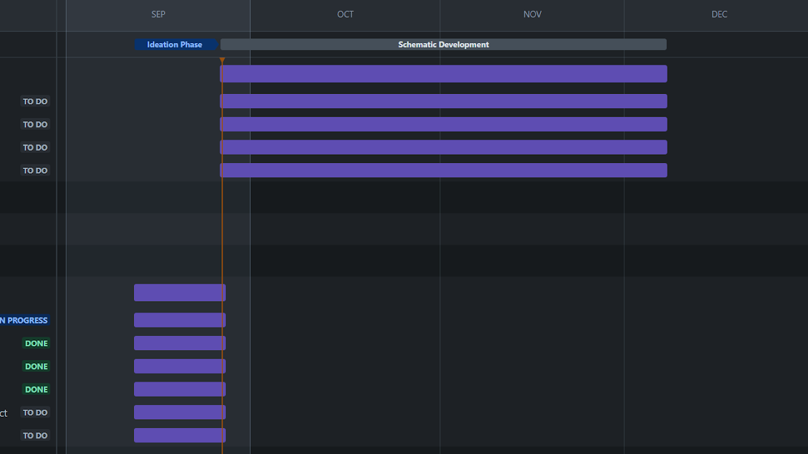
Gantt Chart

Slide 8

Responsibilities
Finish project steps in a timely manner
Adhering to due dates
Equal sharing of project roles
Assisting other team members with their responsibilities
Concise communication between team members though Jira

Slide 9
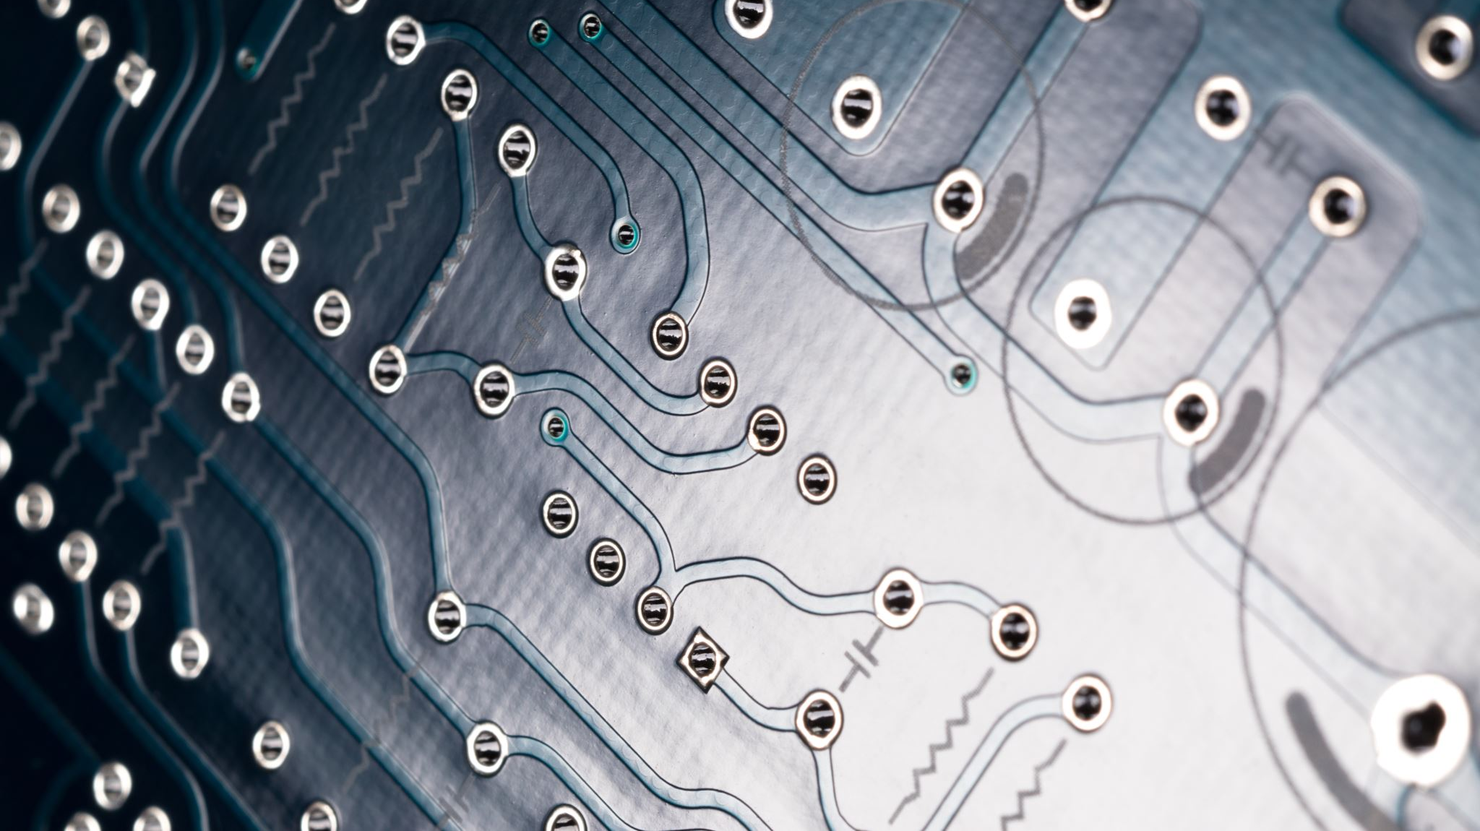
Roles
Joaquin - NFC Research, PCB design/circuit logic, physical design ideas,
Alex - NFC research, PCB design, parts design research
Dylan - 3D modeling, PCB design, circuit logic designer, programming
Austin - parts design research, programming, amiibo reverse-engineering, physical design ideas

Slide 10
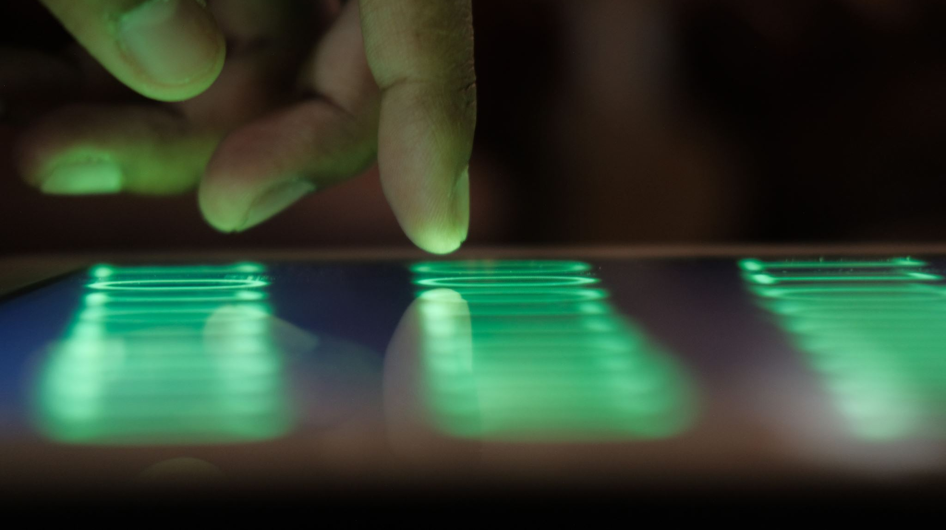
Test to do When Complete
Connecting two units together simultaneously
Each unit connected in tandem must be able to run as expected and identify the Amiibo being placed on the unit
Colors must change as expected inside the shelf when the associated Amiibo is placed on the shelf.

Slide 11
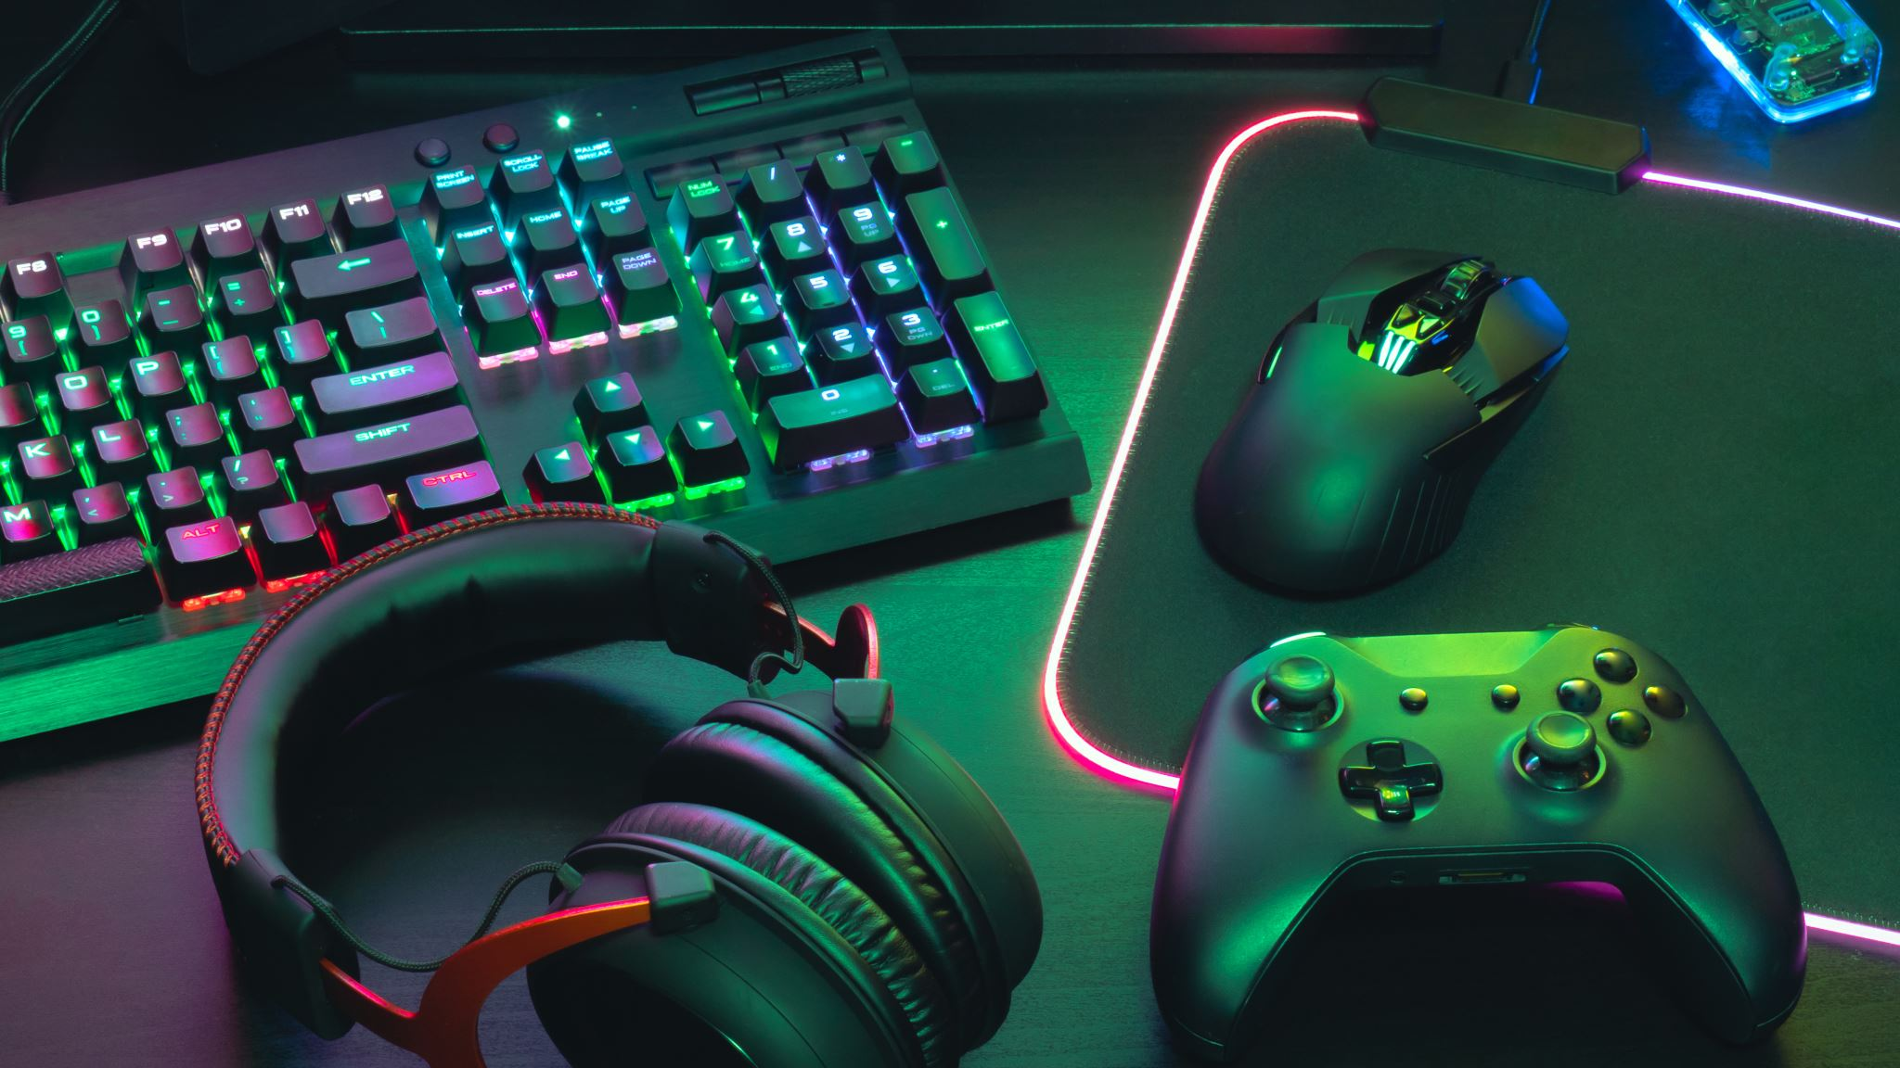
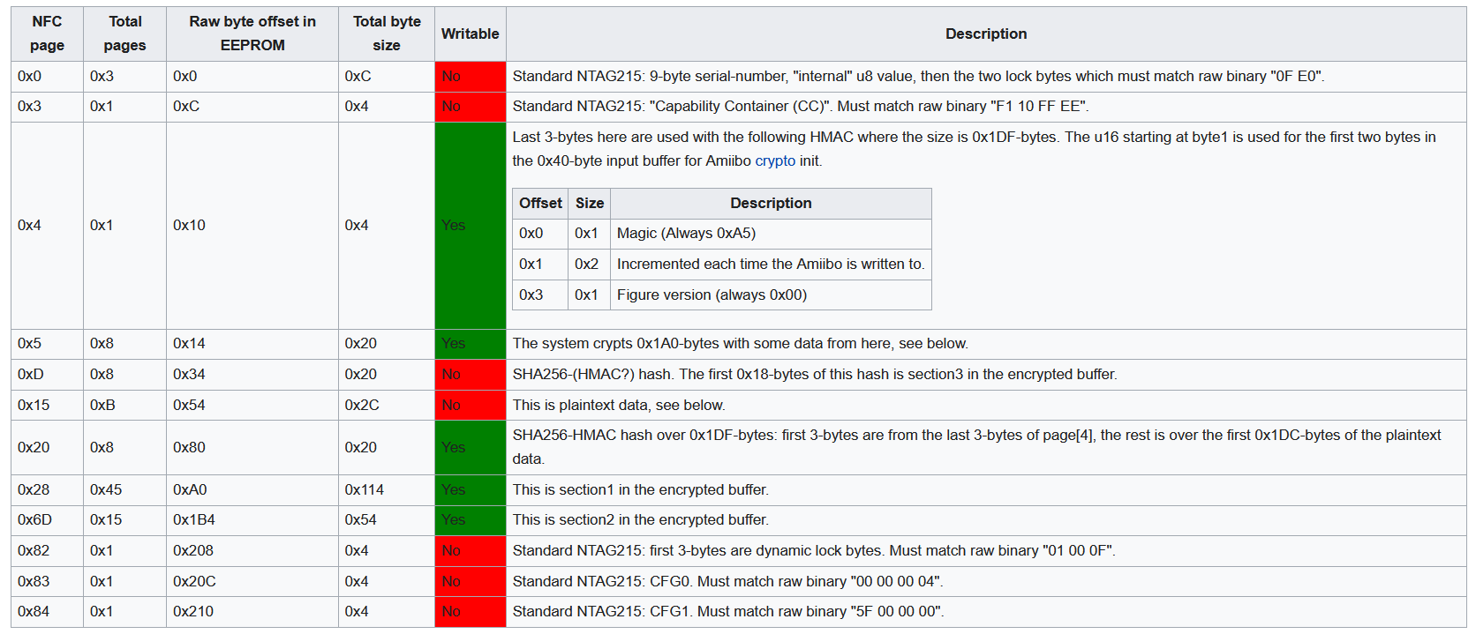
Code of Ethics
Circumnavigating the legality of reverse engineering proprietary information about a pre-existing product without the source company’s consent
Creating a device that reliably and successfully interacts with an existing product without damaging the existing product or itself

Slide 12
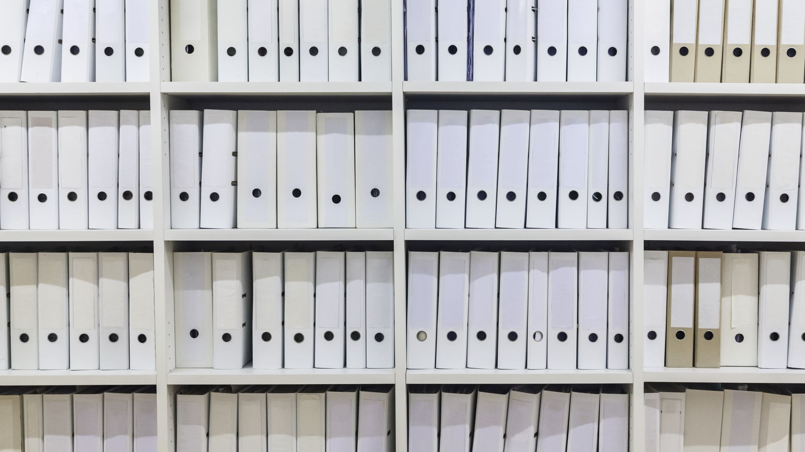
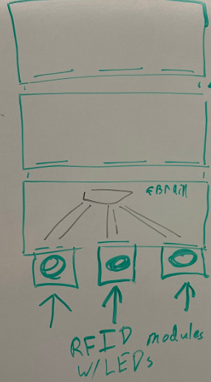
General Scope of the Project
Our project will consist of individual shelves that will house 3 Amiibo.
Each Amiibo will have an RFID scanner to itself and will have LEDs lighting up the box inside the shelf when scanned.
Each shelf will have the capability to link to another shelf to allow for seamless power transfer between multiple shelves.

Slide 13
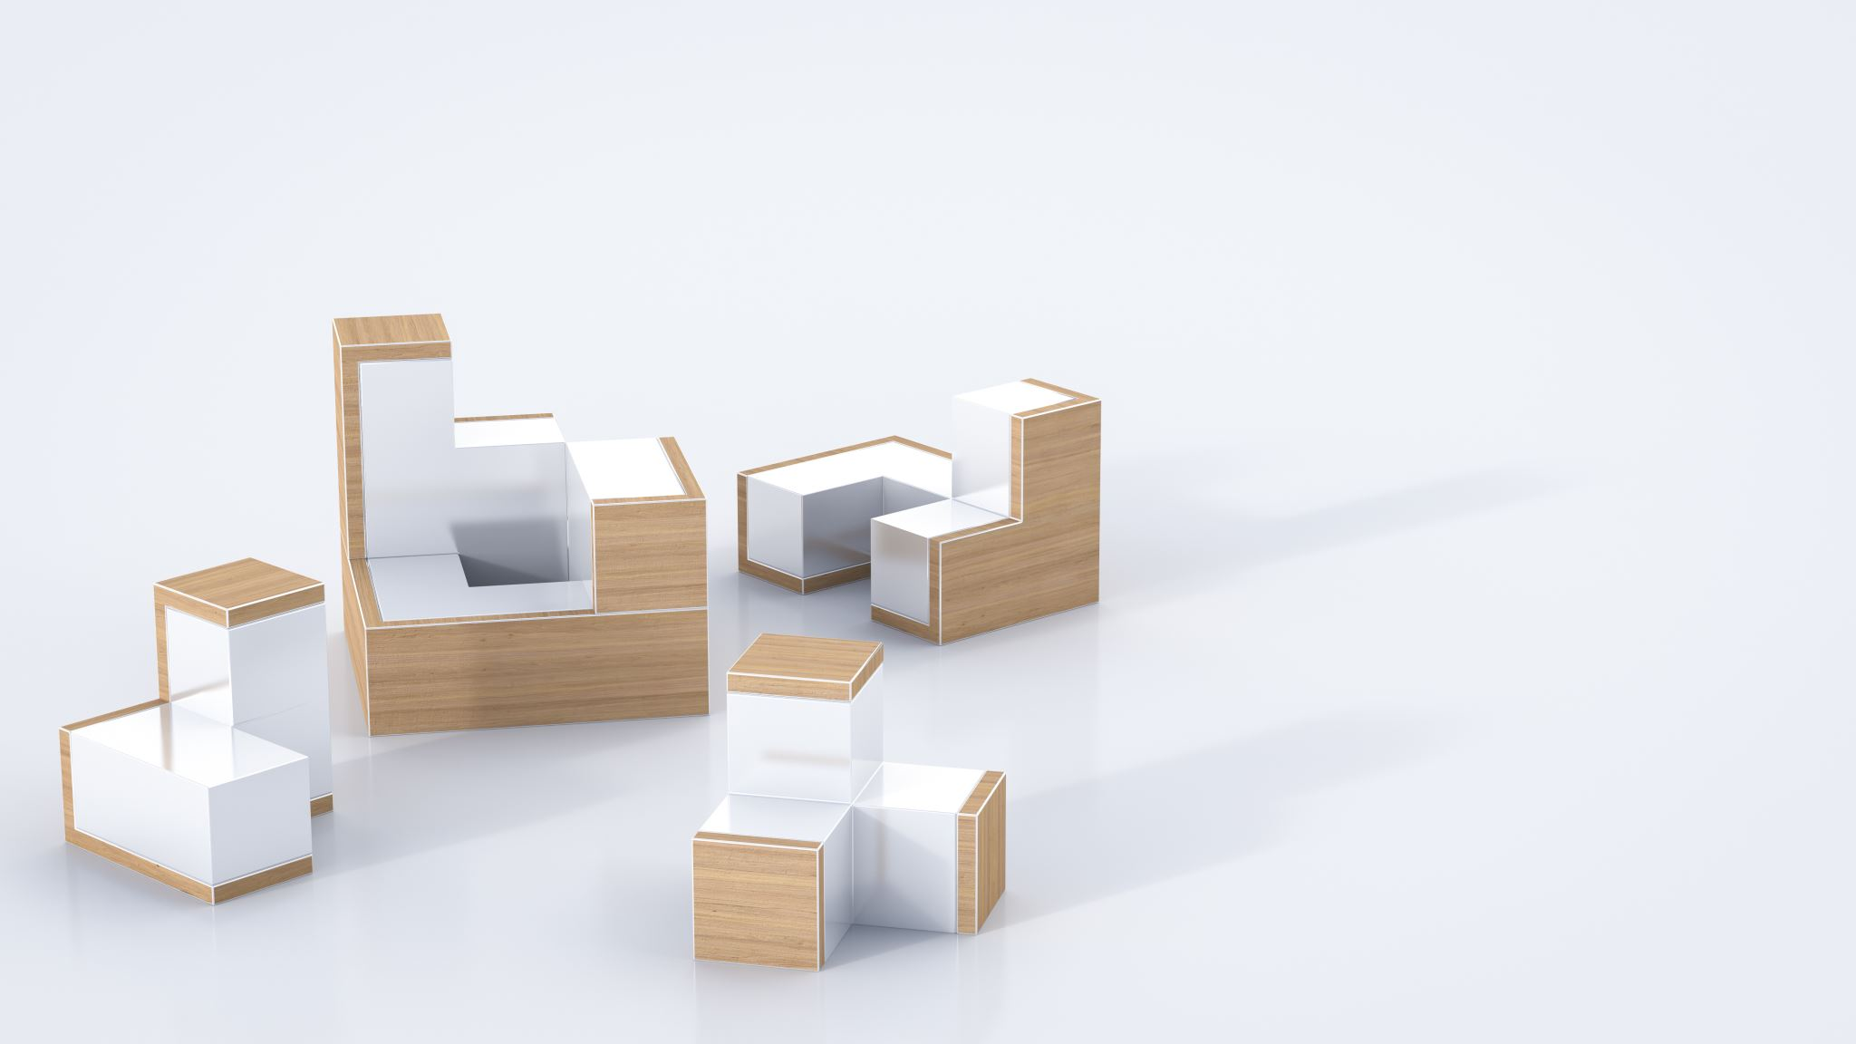
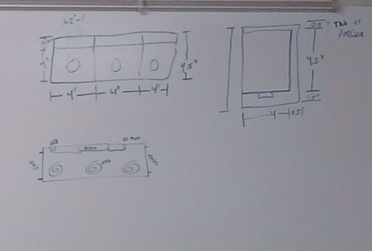
Layout of the Project
Our product layout will allow for 3 Amiibo to be placed into the display shelf within the defined (slightly recessed) slots.
We have allotted enough space within the unit so that the Amiibo will not interfere with each other when slotted into position.
There will be two walls on the ends of the shelving unit which will both physically stop the amiibo from falling out from either side, but will also allow us to hide the internal wiring and circuitry that allows for the power transfer features in the modularity aspect of the shelf.

Slide 14
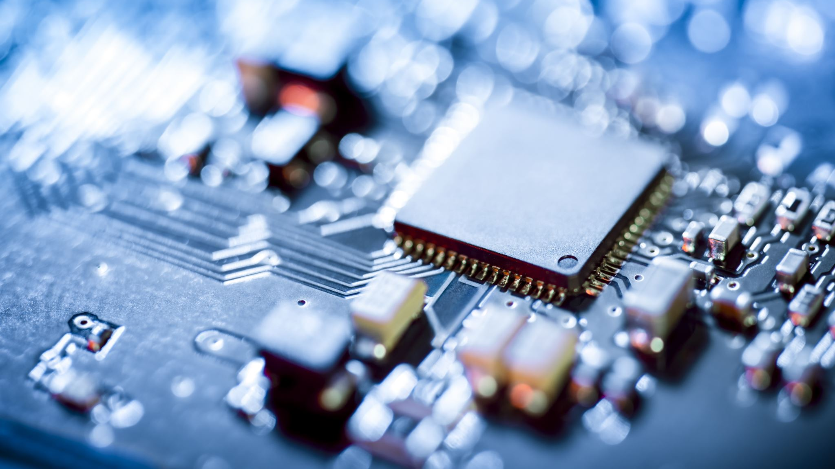
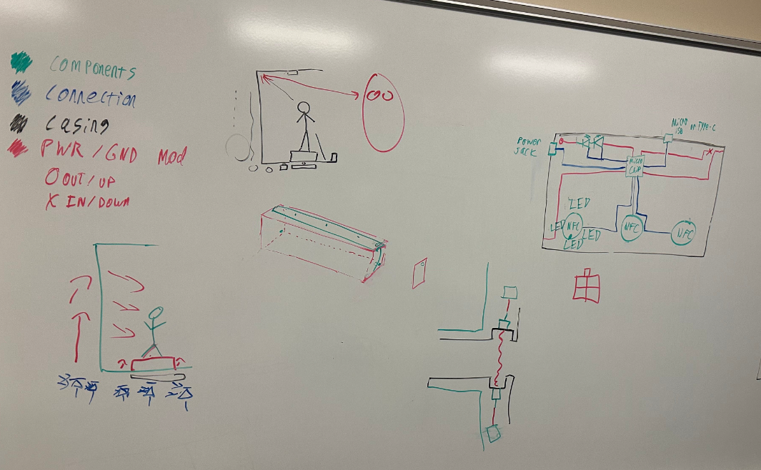
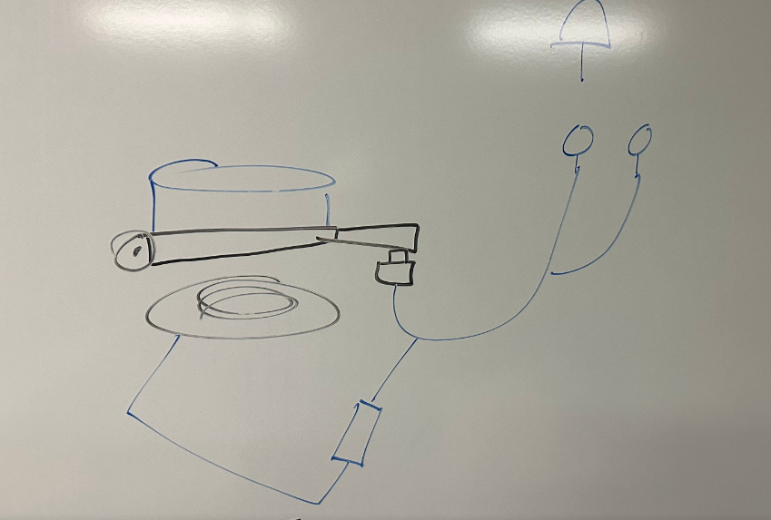
Internal circuitry Logic
Internal circuitry will consist of a custom-made PCB that houses:
Arduino Mega
LED circuits
3 NFC readers
button to detect if a miniature is placed on the NFC reader.

